Slide 1

RECAP Workshop WP5
Statistical Methods for combined data sets: Theory, techniques and tools.
Stef van Buuren, Manon Grevinga, Aurélie Piedvache
https://stefvanbuuren.github.io/RECAPworkshop/

Slide 2
Introduction
Challenges for WP5:
Harmonization of the data
Cohorts collected different variables
Cohorts collected data in different countries
Loss to follow up
Individual prediction
Can all be solved from a missing data perspective.

Slide 3
Introduction
During this workshop we will address questions like:
What are different ways of “combining data”? When are data linked?
What can we do if response categories are different? How do our harmonization strategies affect our later analyses?
What can we do if variables are entirely missing in some sources? What is the effect on later analyses?
What statistical analyses can we do if our cohort shrinks due to loss-to-follow-up?
Can we analyze combined data just as ‘normal’ data? When do we need a multilevel model, and how to do it?

Slide 4
Table of Contents
Introduction
Practicalities
Combining data sets and missing data
Multiple Imputation (MI)
Creating comparable variables
Developmental milestones
Loss to Follow Up
Multilevel Analysis

Slide 5
Table of Contents
Combining data sets and missing data
Datasets can be similar/be different on:
The variables they collected
The subjects included in the study
Based on these differences or similarities there are different ways to combine datasets.

Slide 6
Table of Contents
Multiple Imputation
Datasets can have missing values for multiple reasons.
Multiple imputation creates several complete datasets, where the missing values are replaced by plausible values.
In the analysis one takes the uncertainty about these plausible values into account.

Slide 7
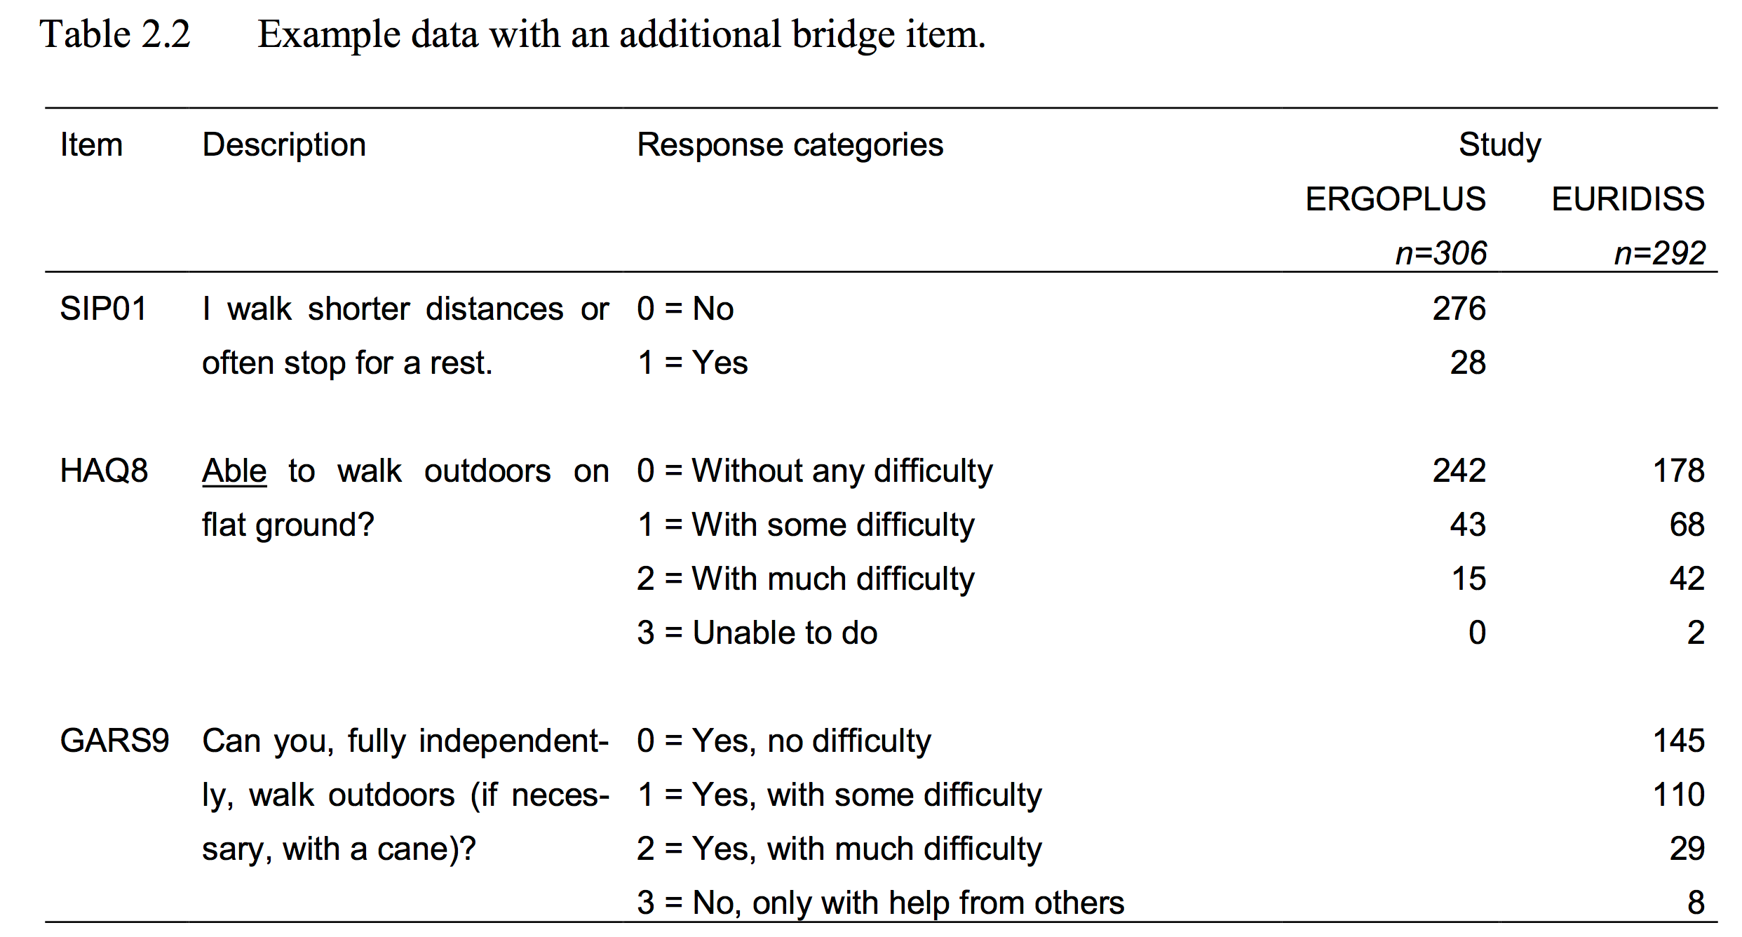
Table of Contents
Creating comparable variables
Are item SIP01 and GARS9 measuring the same construct?
Can we recode SIP01 and/or GARS9 to make them comparable?

Slide 8
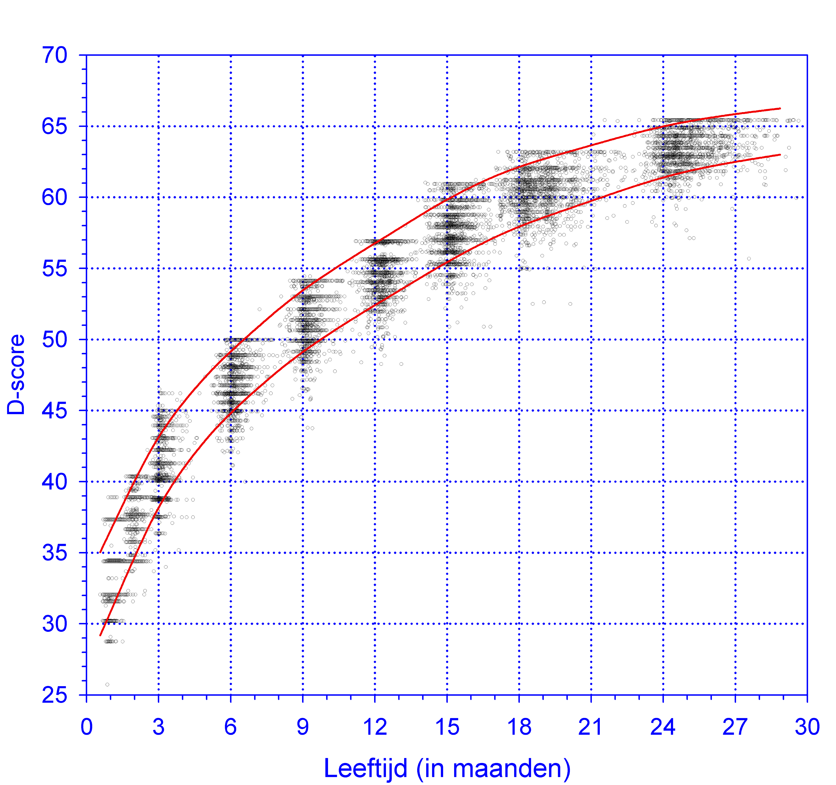
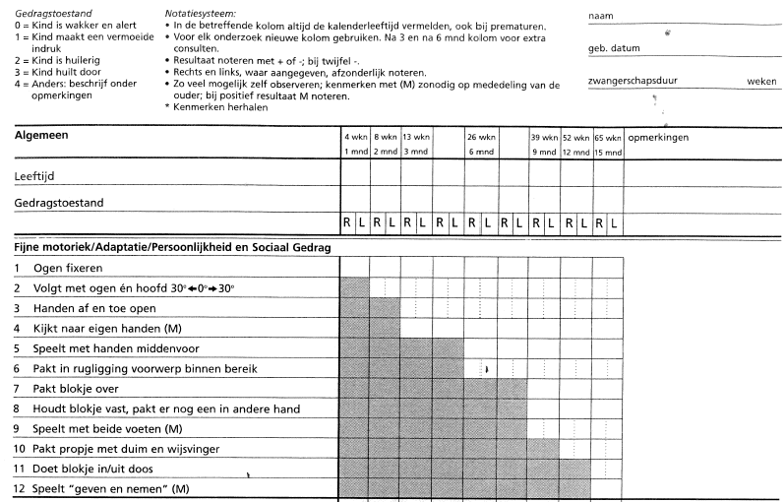
Table of Contents
Developmental Milestones D-score

Slide 9
Table of Contents
Loss-to-follow-up
With longitudinal studies there is often loss-to-follow-up: no information is available for some of the subjects when they get older.
This results in missing values in the data.
Are the missing values/subjects independent of the outcome variable(s)?
Can we take this into account when analyzing the data?

Slide 10
Table of Contents
Multilevel Analysis
Is it okay to assume that all observations are independent of each other, even though we combined multiple datasets from different cohort studies?
E.g., we expect that children from one mother are more similar than to a randomly chosen child from a different mother.
Does this also hold for cohort studies?

Slide 11
Practicalities
SCHEDULE MONDAY
Time | Topic | Remarks
13:00 – 14:30 | Combining datasets & missing data | Theory
14:30 – 15:00 | Break
15:00 – 16:00 | Multiple imputation | Theory & practical
16:00 – 16:30 | Break
16:30 – 18:00 | Creating comparable variables | Theory & practical
19:00 - … | Dinner | @ Scarlatti

Slide 12
Practicalities
SCHEDULE TUESDAY
Time | Topic | Remarks
09:00 – 10:30 | Developmental milestones | Theory & practical
10:30 – 11:00 | Break
11:00 – 12:30 | Loss-to-follow-up | Theory & practical
12:30 – 14:00 | Lunch break
14:00 – 15:00 | Multilevel analysis | Theory & practical
15:00 – 15:30 | Break
15:30 – 17:00 | Discussion

Slide 13
Practicalities
Materials and setup
Software:
R (http://cran.r-project.org/)
R-studio might also be useful. (http://rstudio.com/)

Slide 14
Combining data sets & missing data

Slide 15
Combining Data Sets: Why?
Classic meta analysis
Increase the sample size → more certainty about the result(s)
Individual patient data (IPD)
disentangle subject-level and study-level sources of heterogeneity in treatment effect;
study effect modification;
adjust for confounding variables;
improve data quality;
standardize definitions and analyses;
obtain complete follow-up data on all randomized participants;
combine studies with different follow-up times;
analyze multiple outcomes;
investigate long-term outcomes;
investigate rare exposures.

Slide 16
Combining Data Sets: Why not?
At least 10 reasons
Studies measure collect different sets of variables that measure the same construct;
Studies apply different measurement instruments;
The timing of the measurements varies widely between studies;
Study employ different designs to select units, or to allocate treatments;
Data are missing for different reasons, e.g. loss to follow up, not administered, skipped;
The key to link data from the same individual is imprecise, absent or contains duplicates;
The original data were collected for different analytic objectives;
Data may be sensitive, and at risk for de-identification after combining;
Definitions and classification may change over time;
Access to the original study sources is restricted.

Slide 17
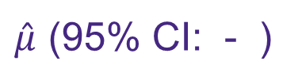
Combining Data Sets
Start
End
$\hat{μ}$ (95% CI: - )
this workshop
point estimate &
confidence interval
datasets

Slide 18
Combining Data Sets
Questions: Two datasets:
What are different ways of ‘combining data’?
When are data linked?
There are two ways to combine them:
Join (next to each other)
Add (among each other)

Slide 19
Combining Data Sets: Join
Requirements:
Same subjects
Different variables
Not every subject needs to be included in both datasets.
Four Join combining ways:
Inner join
Full outer join
Master join
Detail join
Two datasets:
ID X1 X2 X3 X4 X5 X6
1
2
3
4
5
6
X4 X5 X6
X4 X5 X6
ID X1 X2 X3
1
2
3
4
5
6
ID X4 X5 X6
1
2
3
4
5
6

Slide 20
Combining Data Sets: Inner Join
Requirements:
Same subjects (not all have to be similar)
Different variables
With Inner Join only keep the rows (subjects) that exist in both datasets.
Two datasets:
ID X1 X2 X3 X4 X5 X6
1
2
4
6
ID X1 X2 X3 X4 X5 X6
1
2
3
4
5
6
X4 X5 X6
X4 X5 X6
ID X1 X2 X3
1
2
3
4
5
6
ID X4 X5 X6
1
2
3
4
5
6

Slide 21
Combining Data Sets: Full Outer Join
Requirements:
Same subjects (not all have to be similar)
Different variables
With Full Outer Join keep all the rows (subjects) with blanks.
Two datasets:
ID X1 X2 X3 X4 X5 X6
1
2
3
4
5
6
ID X1 X2 X3 X4 X5 X6
1
2
3
4
5
6
X4 X5 X6
X4 X5 X6
ID X1 X2 X3
1
2
3
4
5
6
ID X4 X5 X6
1
2
3
4
5
6

Slide 22
Combining Data Sets: Master Join (Left Outer Join)
Requirements:
Same subjects (not all have to be similar)
Different variables
With Master Join keep all the rows (subjects) of one dataset and only the matching rows of the other.
Two datasets:
ID X1 X2 X3 X4 X5 X6
1
3
4
5
6
ID X1 X2 X3 X4 X5 X6
1
2
3
4
5
6
X4 X5 X6
X4 X5 X6
ID X1 X2 X3
1
2
3
4
5
6
ID X4 X5 X6
1
2
3
4
5
6

Slide 23
Combining Data Sets: Detail Join (right outer join)
Requirements:
Same subjects (not all have to be similar)
Different variables
With Detail Join keep all the rows (subjects) of one dataset and only the matching rows of the other.
Two datasets:
ID X1 X2 X3 X4 X5 X6
2
3
4
6
ID X1 X2 X3 X4 X5 X6
1
2
3
4
5
6
X4 X5 X6
X4 X5 X6
ID X1 X2 X3
1
2
3
4
5
6
ID X4 X5 X6
1
2
3
4
5
6

Slide 24
Combining Data Sets: Add
ID X1 X2 X3
1
2
3
4
5
6
7
8
9
10
11
12
Requirements:
Different subjects
Same variables (not all have to be similar)
Two datasets:
ID X1 X2 X3
1
2
3
4
5
6
ID X1 X2 X3
7
8
9
10
11
12

Slide 25
Combining Data Sets: Add
ID X1 X2 X3
1
2
3
4
5
6
7
8
9
10
11
12
Requirements:
Different subjects
Same variables (not all have to be similar)
Not every variable needs to be included in both datasets.
Again two options:
Keep X3
Drop X3
Two datasets:
ID X1 X2
1
2
3
4
5
6
ID X1 X2 X3
7
8
9
10
11
12

Slide 26
Combining Data Sets: Add
ID X1 X2 X3 X4
1
2
3
4
5
6
7
8
9
10
11
12
Requirements:
Different subjects
Some similar variables, some different variables
Two datasets:
ID X1 X2 X3 X4
1
2
3
4
5
6
ID X1 X2 X3 X4
7
8
9
10
11
12

Slide 27
Combining Data Sets: Add
ID X1 X2 X3 X4
1
2
3
4
5
6
7
8
9
10
11
12
Requirements:
Different subjects
No similar variables
Two datasets:
ID X1 X2 X3 X4
1
2
3
4
5
6
ID X1 X2 X3 X4
7
8
9
10
11
12

Slide 28
Missing data perspective
Ideal Data: envision what data we would like to have had to solve our problem given unlimited resources;
Ideal Analysis: define what analysis we would perform if we had the ideal data;
Available Data: evaluate which parts of the ideal data are available to us;
Missing data: determine why some parts of the ideal data are missing;
Replications: construct replications of the unseen ideal data;
Calculate: our answer from each replication by the method of point 2;
Summarize: the answer over the replications.

Slide 29
Multiple imputation

Slide 30
Missing data
In general, missing data can severely complicate interpretation and analysis.
Causes of missing data:
Respondent skipped the item
Data transmission/coding error
Drop out in longitudinal research
Refusal to cooperate
Sample from population
Question not asked, different forms
Branching, routing
Censoring
Combining data

Slide 31
Missing data
When subjects are followed over time they can behave in three different ways:
Complete case Subject has all measurements and hence has no missing response values.
Monotone missingness (drop-out) Subject starts by having all measurements, but at a certain point in time the measurements are missing and after that no measurement is recorded.
Non-monotone missingness The subject misses one (or more) measurements, however after a missed measurement there is at least one another measurement.
 | T = 1 | T = 2 | T = 3 | T = 4
Complete case | O | O | O | O
Monotone missingness (drop-out) | O | O | O | M
 | O | O | M | M
 | O | M | M | M
Non-monotone missingness | O | M | O | O
 | O | O | M | O
 | O | M | O | M
 | M | O | O | O
 | … | … | … | …

Slide 32
Missing data
One can make an assumption about the missing mechanism, the missing is:
MCAR: Missing Completely at Random Example: Mother filled in the questionnaire but it was not received because it was lost by the postal service
MAR: Missing At Random Example: Low response from multiparous mothers
MNAR: Missing Not At Random Example: If a child is unable to carry out a task, the mother is more likely to leave blank (missing)

Slide 33
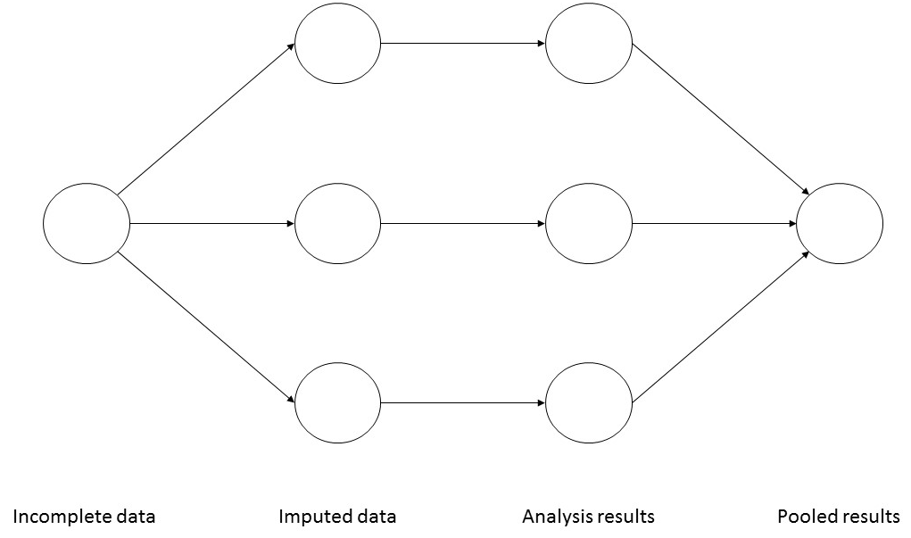
Multiple Imputation (MI)
Main steps used in multiple imputation
Multiple imputation creates several m > 1 complete datasets, where the missing values are replaced by plausible values.
Each of these datasets is analyzed using standard software, and the m results are then pooled in to a final point estimate.
The magnitude of the difference between the imputed data points tells us something about the uncertainty about the imputed value: the bigger the difference the more uncertain we are.

Slide 34
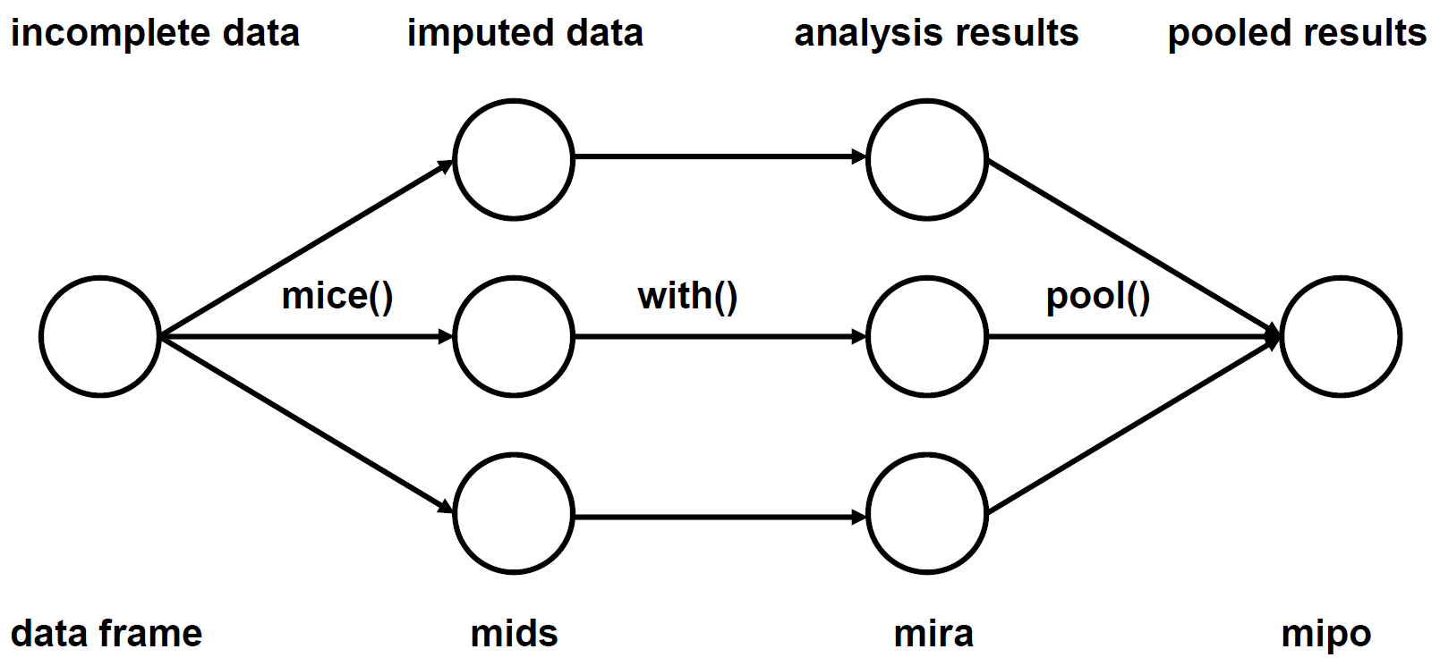
Multiple Imputation (MI)
Steps in mice

Slide 35
Multiple Imputation (MI)
How large should m be?
Use m = 5 or m = 10 if the fraction of missing information is low
Develop your model with m = 5. Do final run with m equal to percentage of incomplete cases.
Repeat the analysis with m = 5 with different seeds. If there are large difference for some parameters, this means that the data contain little information about them.

Slide 36
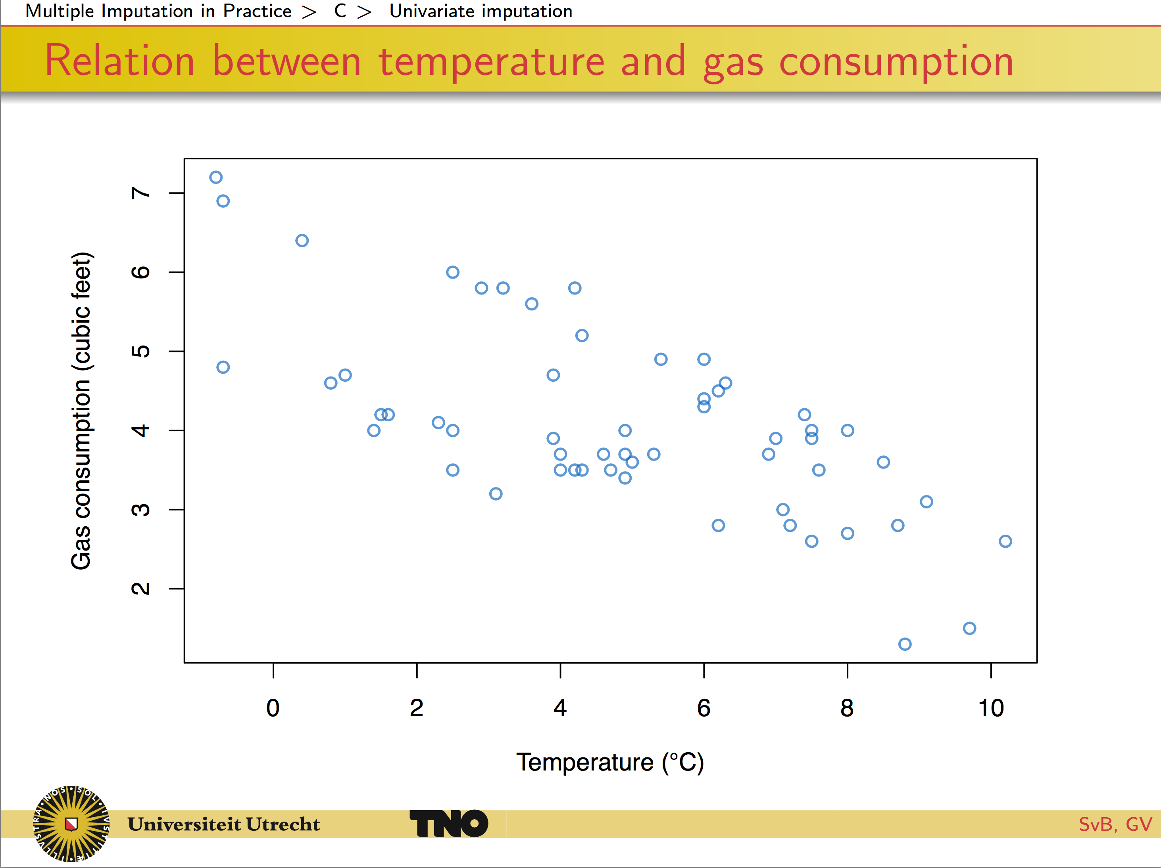

Slide 37
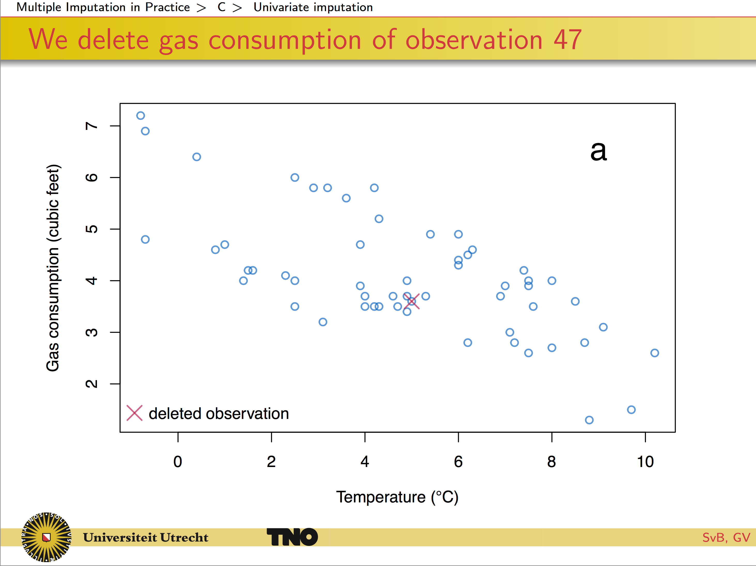

Slide 38
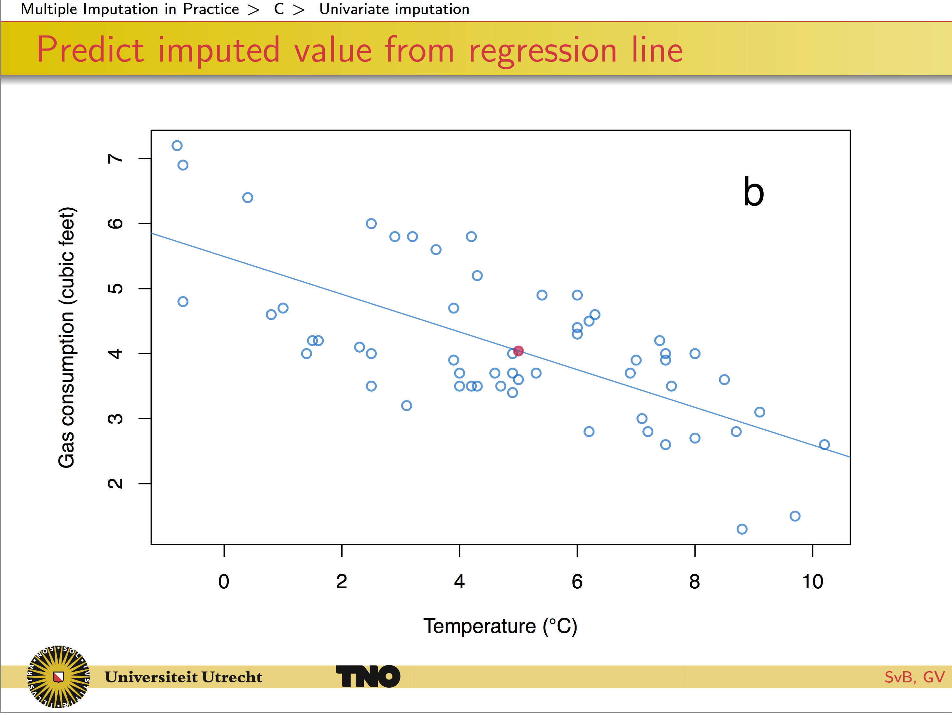

Slide 39
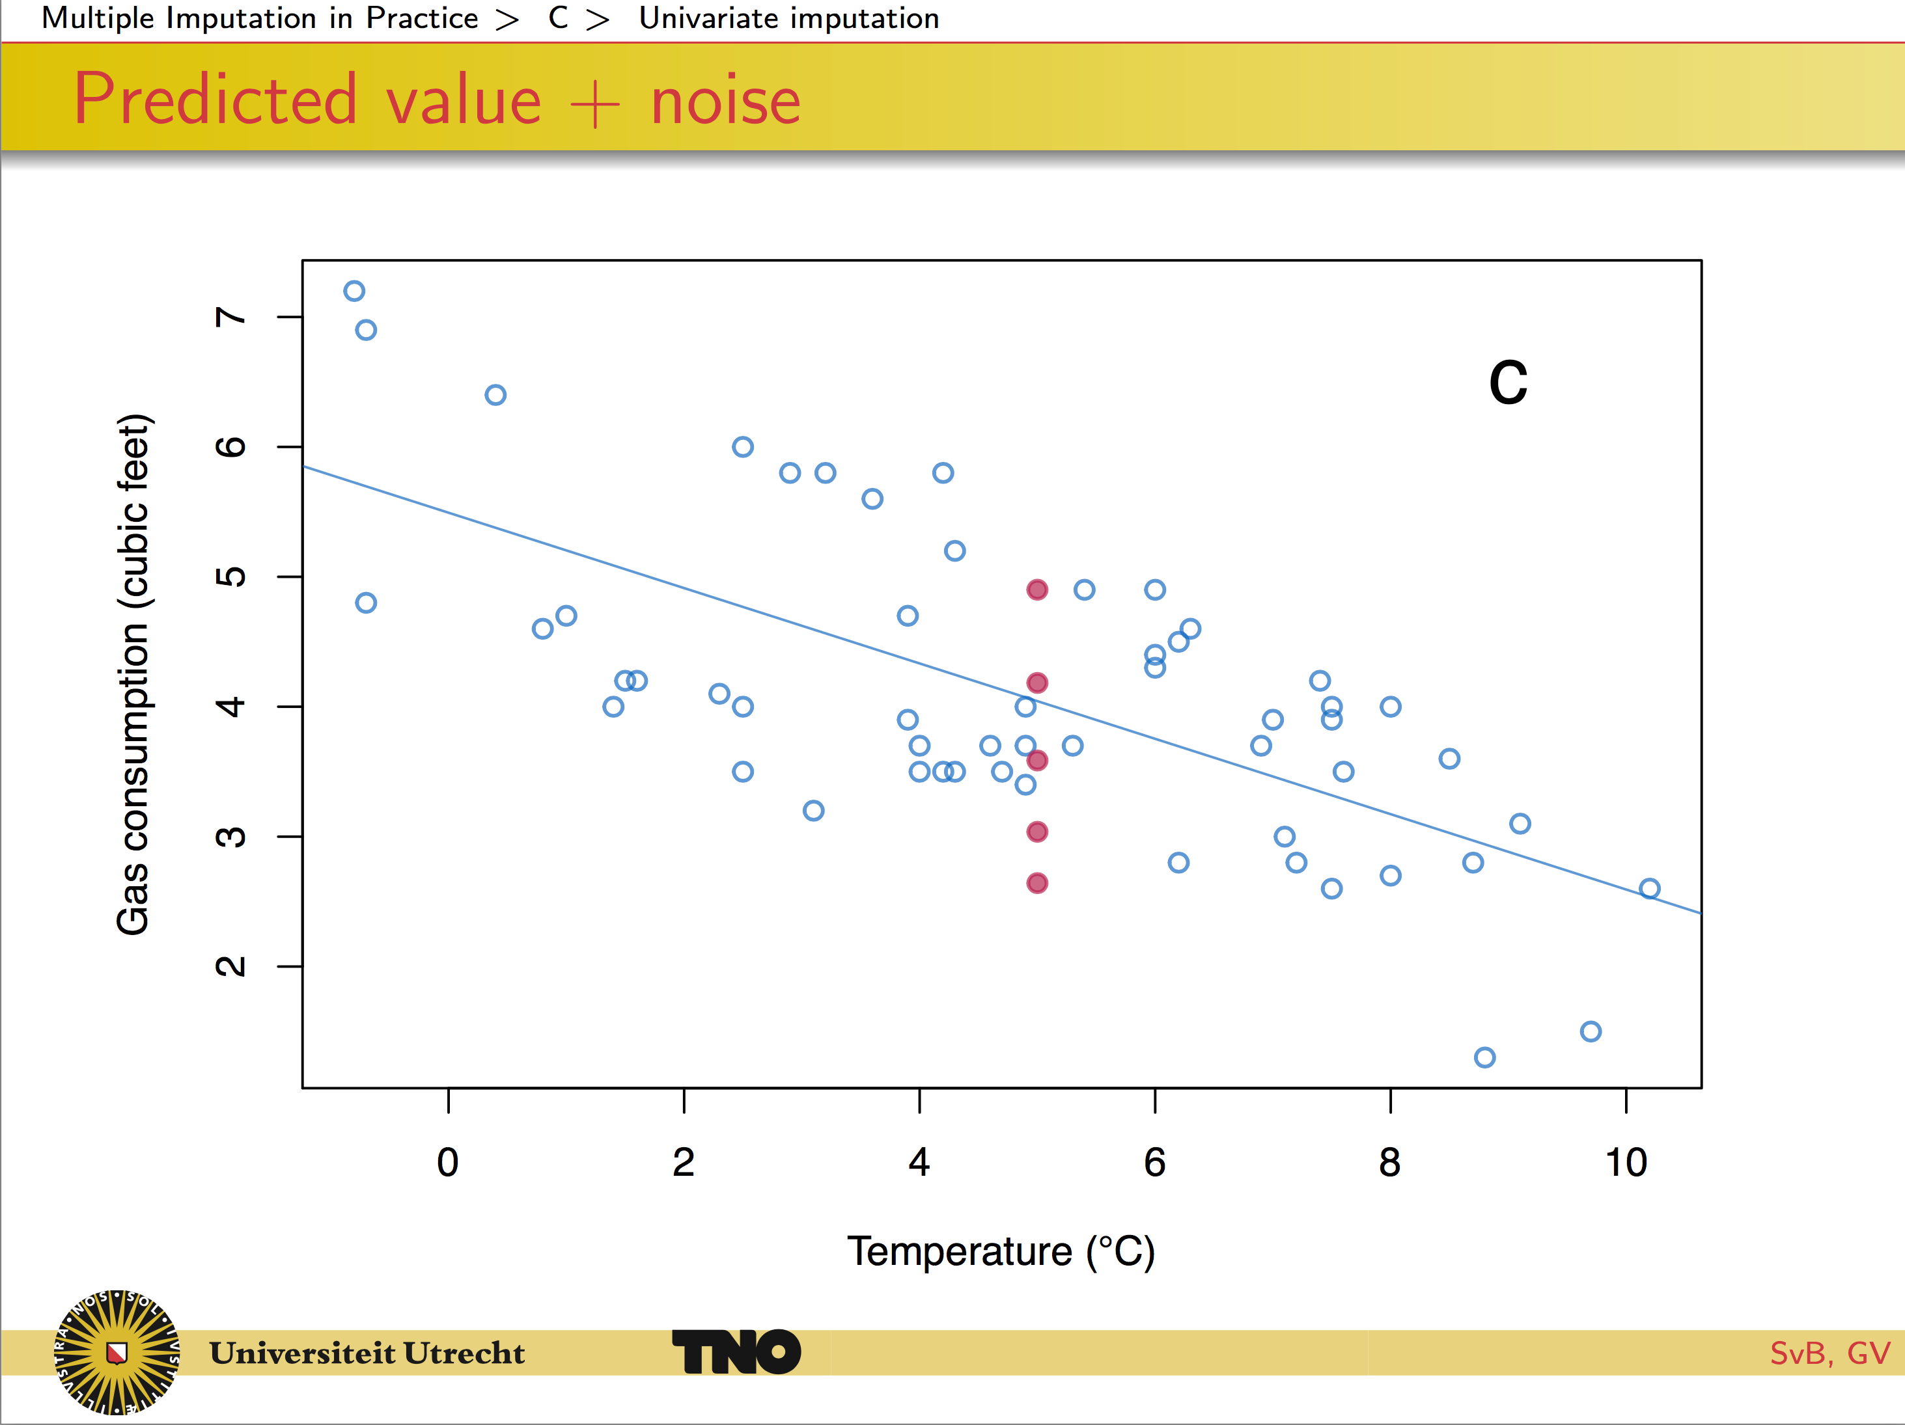

Slide 40
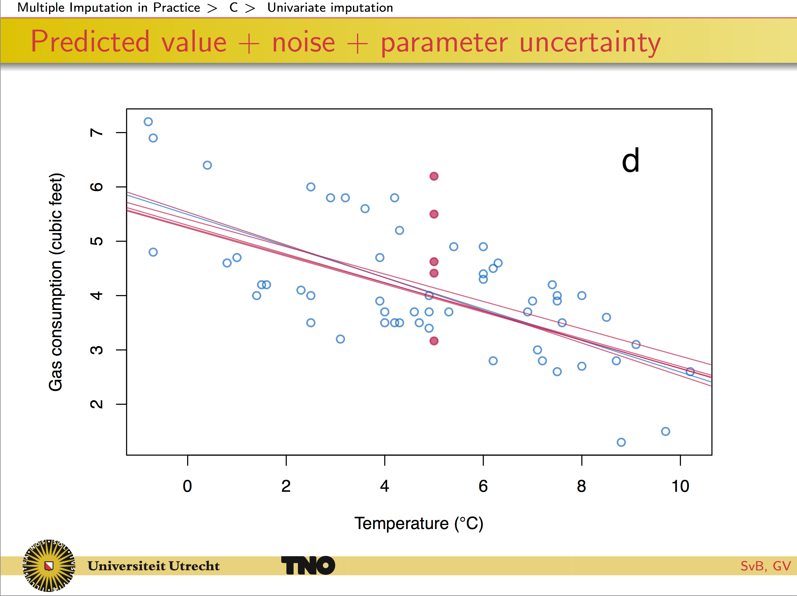

Slide 41
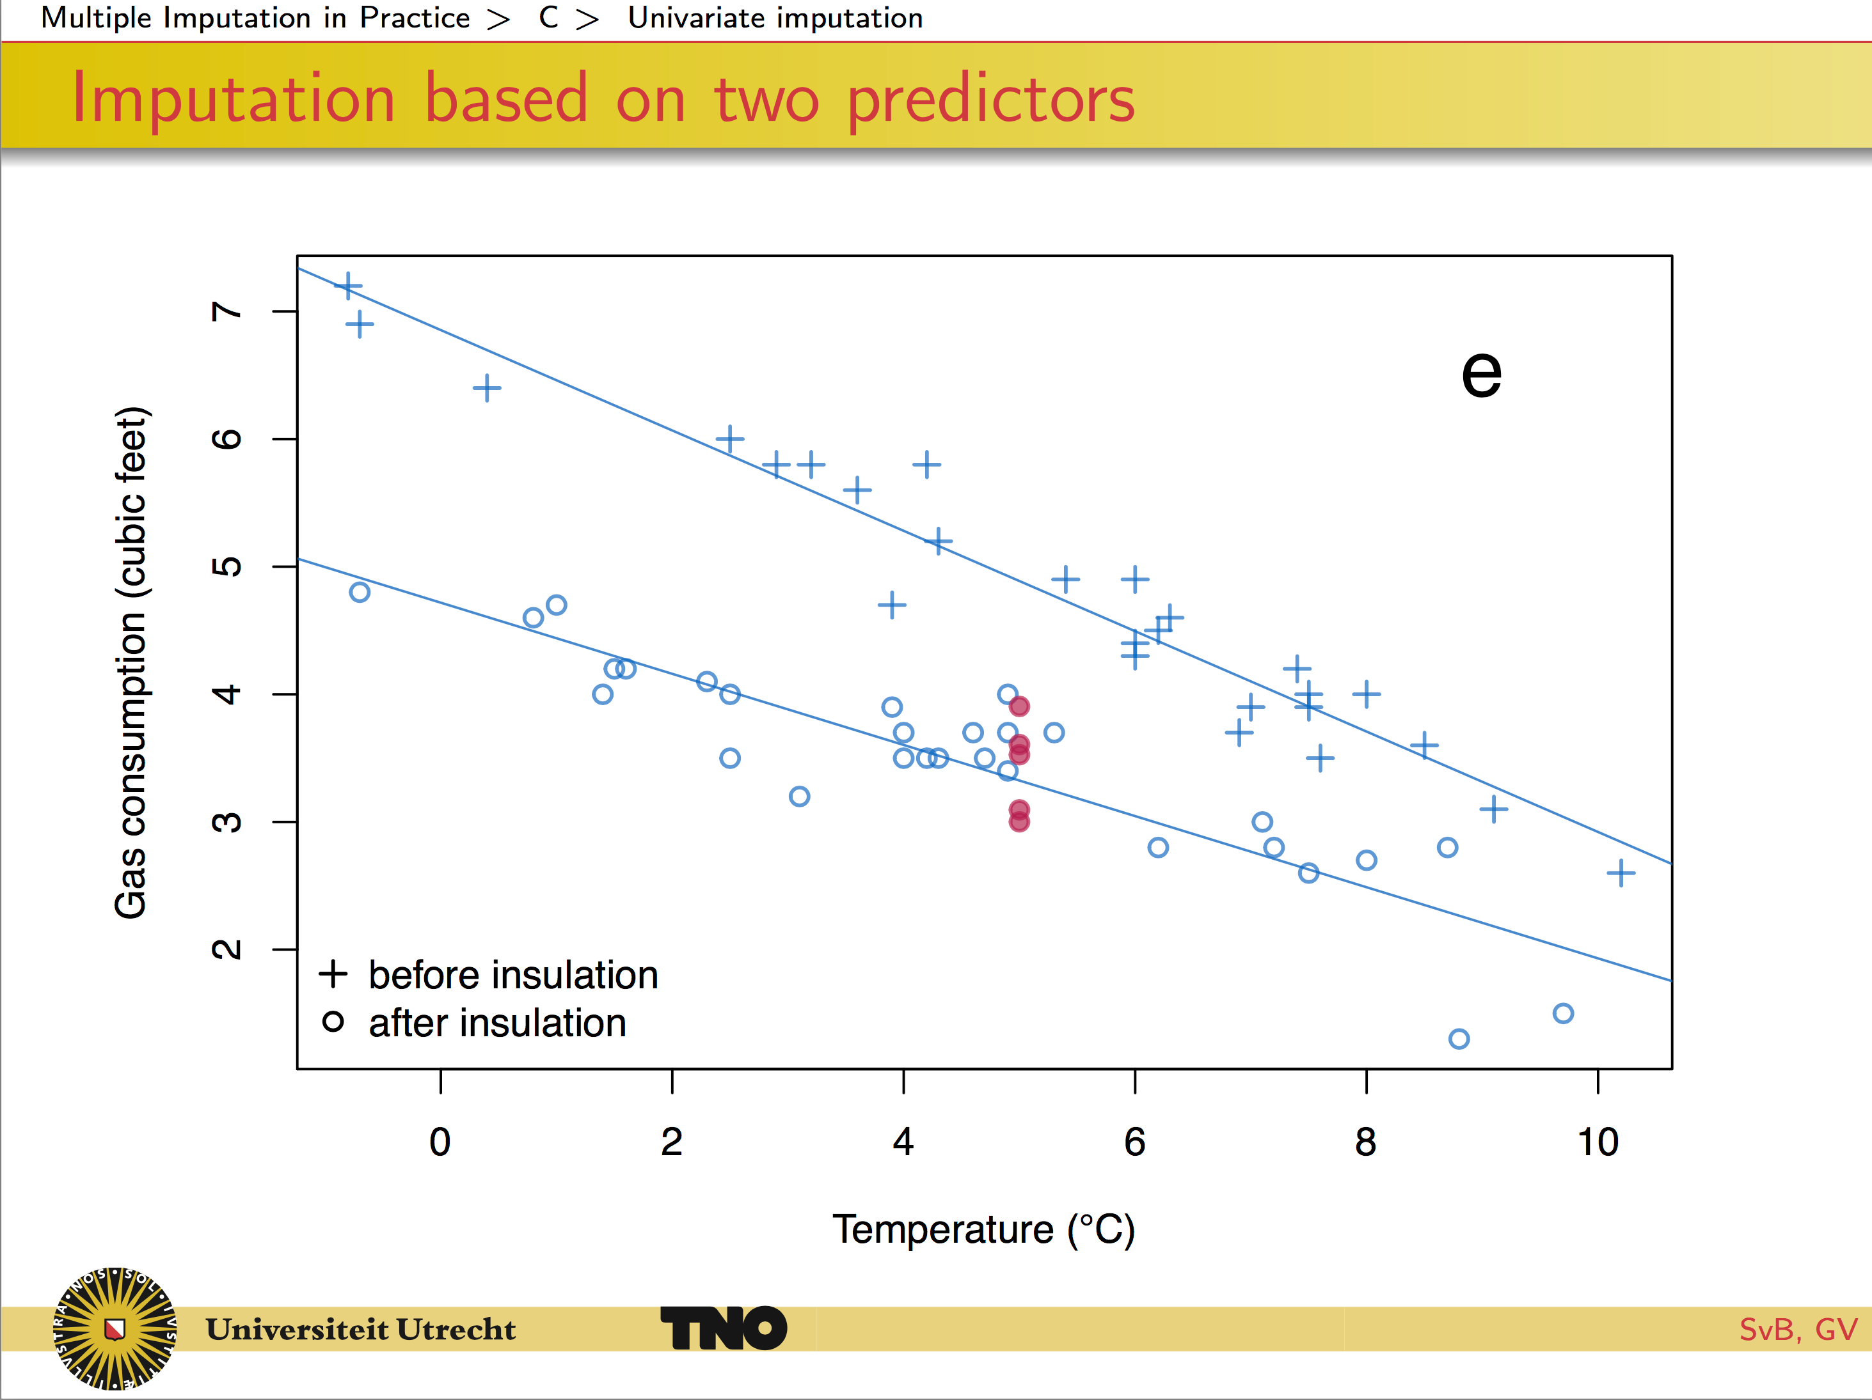

Slide 42
Multiple Imputation (MI)
Three sources of variation
The variance cause by the fact that we are taking a sample rather than the entire population. (this is the conventional statistical measures of variability)
The extra variance caused by the fact that there are missing values in the sample
The extra simulation variance cause by the fact that the total variance itself is based on finite m.

Slide 43
Creating Comparable Variables

Slide 44
Creating Comparable Variables
When combining data from cohort studies we want to add the datasets, since the cohorts study the same phenomena with different subjects.
However, the way these cohort studies investigated the phenomena might differ.
For example, all cohort studies might have the same survey question, however the categorical responses for this question differ.
To be able to add these datasets, we would like to harmonize the responses to these survey questions which can be done by e.g. response conversion.

Slide 45
Creating Comparable Variables
Levels of equivalence
5 scalar equivalence: same ratio scale across cohort
4 unit equivalence: same units but different anchors
3 procedural equivalence: common procedure to measure objects, but there is no underlying unit or ordering in the numbers
2 construct equivalence: same concept is measured, but scales differ
1 construct inequivalence: no equivalent concepts across cohorts

Slide 46
Creating Comparable Variables // Recoding
.
Notes:
MCAR is assumed, but not explained before this part…

Slide 47
Creating Comparable Variables // Recoding
.
The trait θ makes up a common scale for walking disability.
Notes:
MCAR is assumed, but not explained before this part…

Slide 48
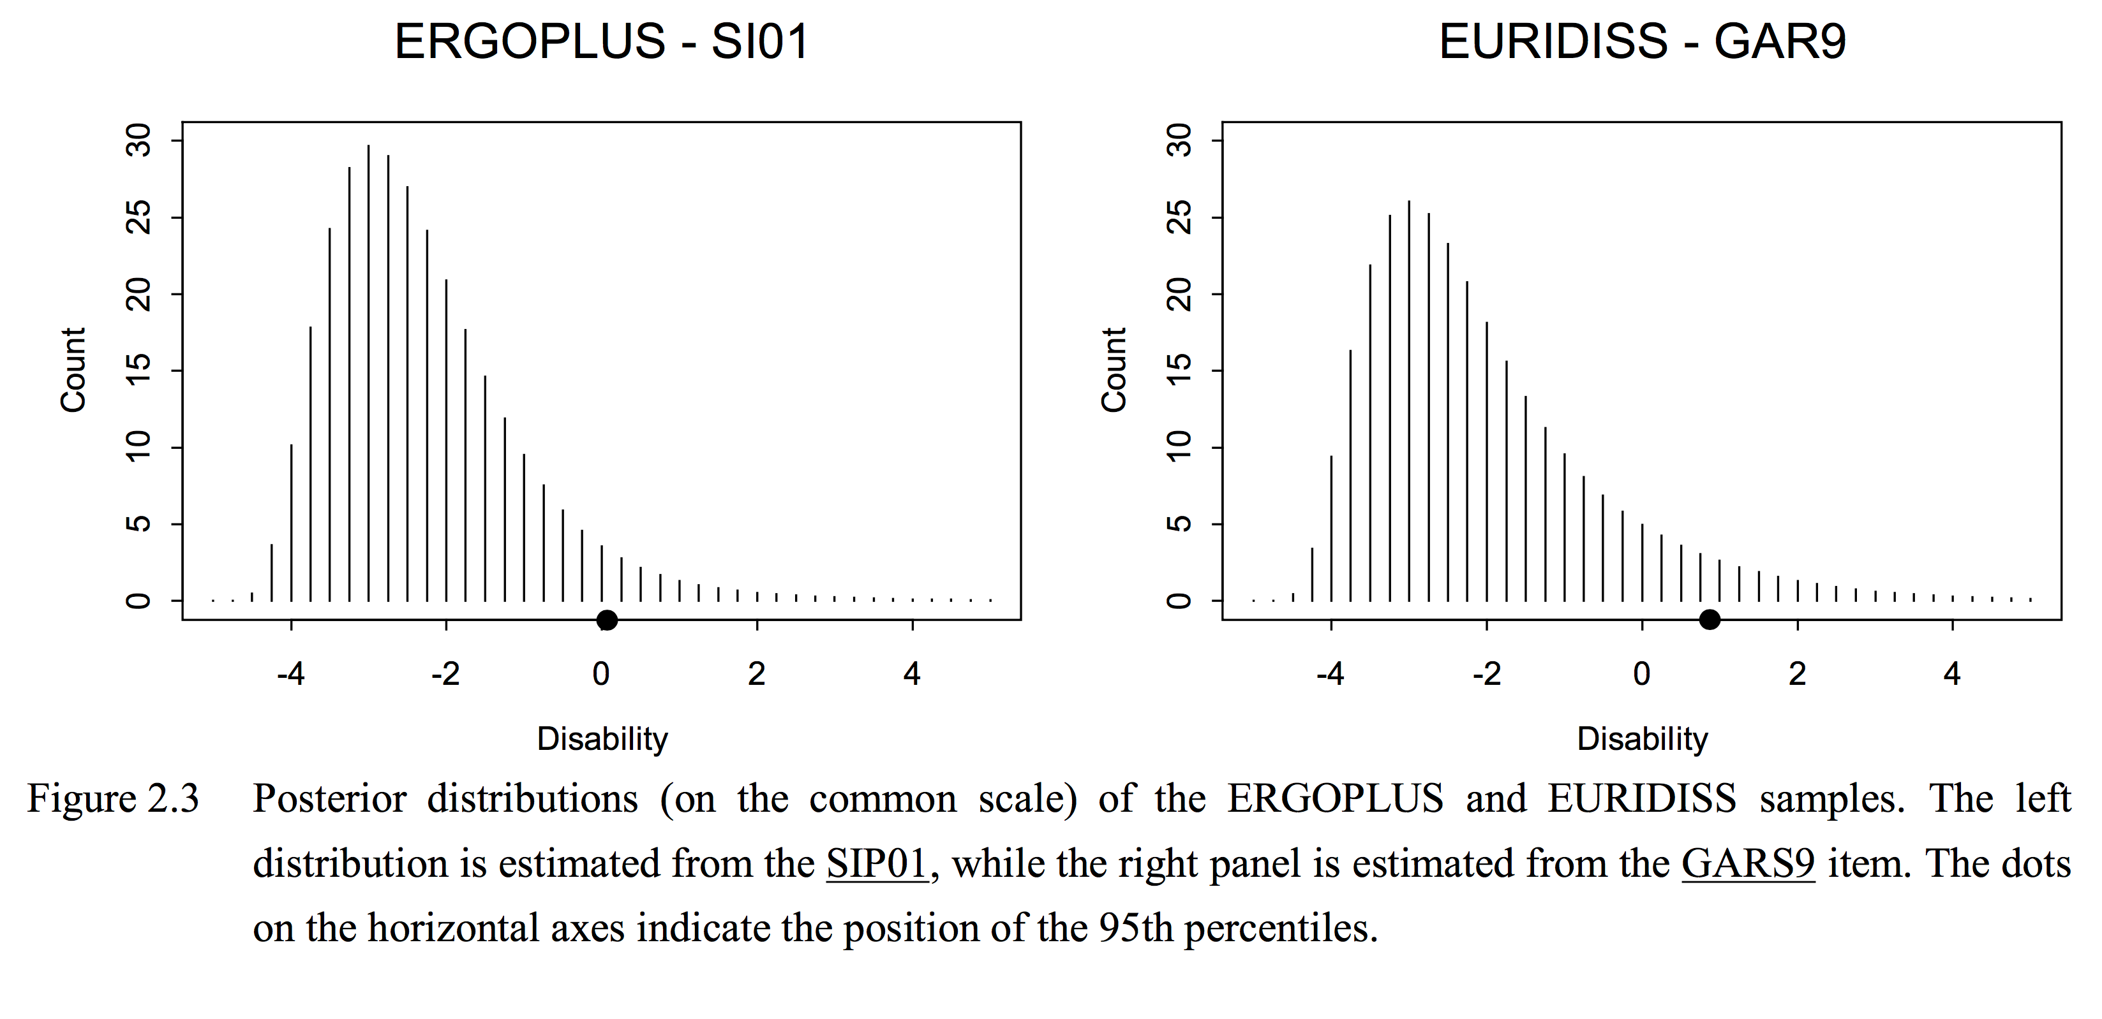
Creating Comparable Variables // Recoding
.

Slide 49
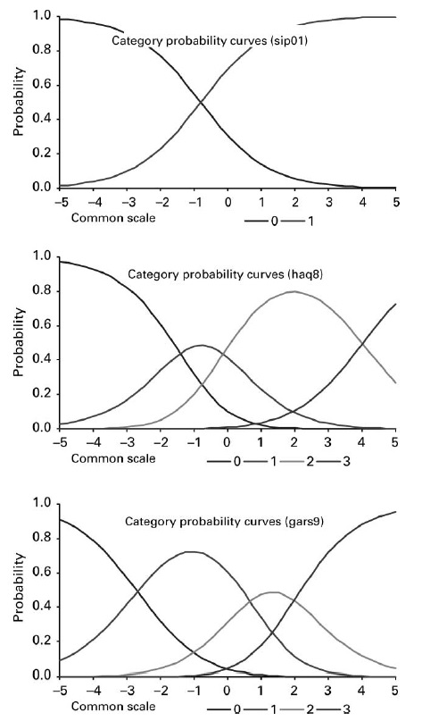
Creating Comparable Variables // Recoding
Horizontal axis: orders walking disability from no disability (left) to high disability(right)
Vertical axis: response probability
For someone with θ_{i} = -1 has a probability of
0.27 of responding in Category 0 of HAQ8
0.50 of responding in Category 1 of HAQ8
0.23 of responding in Category 2 of HAQ8
0.00 of responding in Category 3 of HAQ8

Slide 50
Creating Comparable Variables // Recoding
Horizontal axis: orders walking disability from no disability (left) to high disability(right)
Vertical axis: response probability
For someone with θ_{i} = -1 has a probability of
0.11 of responding in Category 0 of GAR9
0.72 of responding in Category 1 of GAR9
0.16 of responding in Category 2 of GAR9
0.01 of responding in Category 3 of GAR9

Slide 51
Creating Comparable Variables // Recoding
The procedure of response conversion consists of two steps:
Construction of the conversion key
Using the conversion key
The conversion key models the relation between the common scale and the observed data.
It is important that the studies in need for harmonization need at least one identical item/question (bridge item) which can be used to develop the common scale.

Slide 52
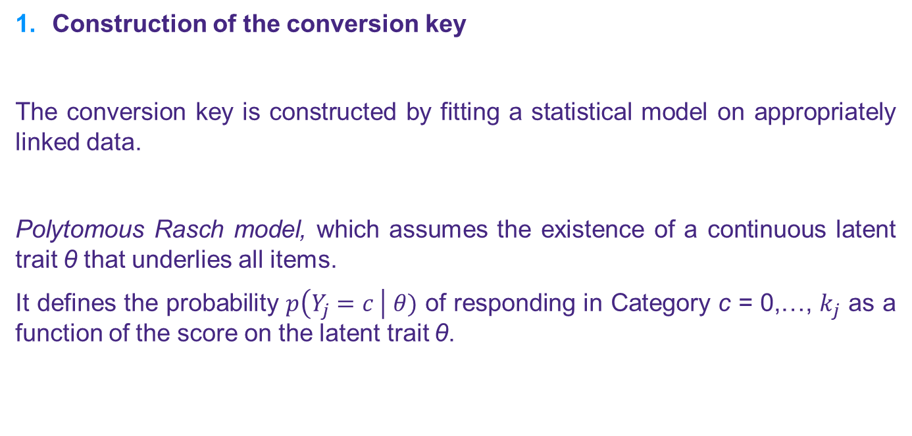
Creating Comparable Variables // Recoding
Construction of the conversion key
The conversion key is constructed by fitting a statistical model on appropriately linked data.
Polytomous Rasch model, which assumes the existence of a continuous latent trait θ that underlies all items.
It defines the probability $p\left(Y_{j}=c \right| θ)$ of responding in Category c = 0,…, $k_{j}$ as a function of the score on the latent trait θ.

Slide 53
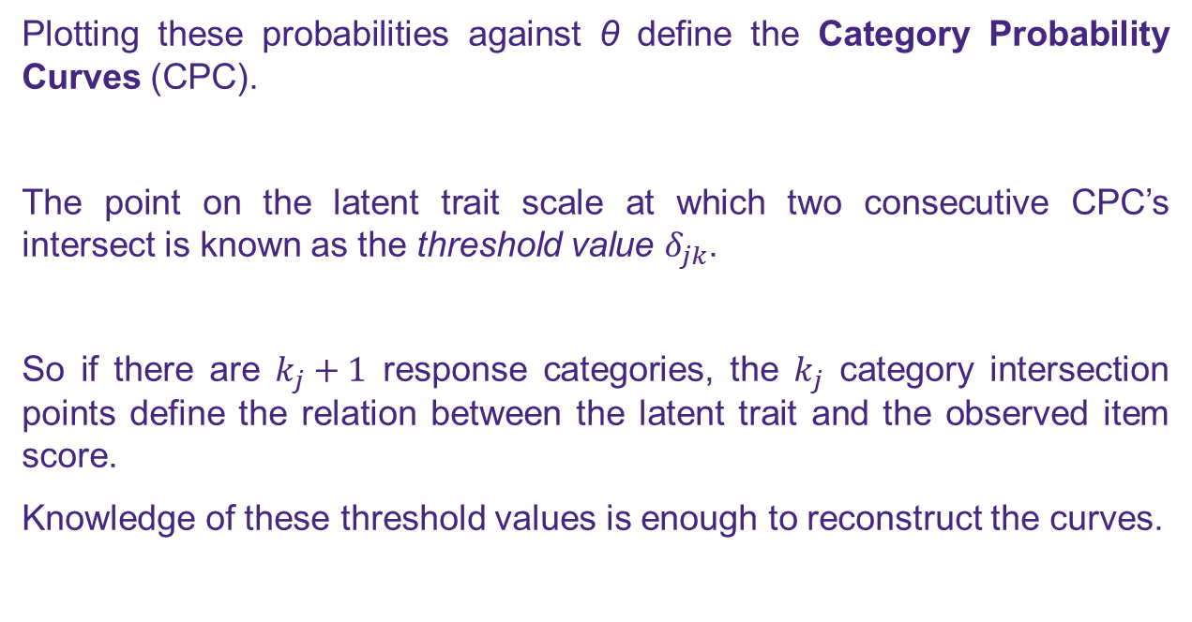
Creating Comparable Variables // Recoding
Plotting these probabilities against θ define the Category Probability Curves (CPC).
The point on the latent trait scale at which two consecutive CPC’s intersect is known as the threshold value $δ_{jk}$.
So if there are $k_{j}+1$ response categories, the $k_{j}$ category intersection points define the relation between the latent trait and the observed item score.
Knowledge of these threshold values is enough to reconstruct the curves.

Slide 54
Creating Comparable Variables // Recoding Conclusion
Problem: Survey questions of cohort studies are more or less equivalent: small differences in the question, or the response categories differ.
Usual approach: one-to-one transformation or dropping the variable
Assumption with this approach: With one-to-one transformation it is assumed that both questions ask for exactly the same. When dropping the variable, it is assumed that the variable does not influence the response.
Solutions available: response conversion
How does it work?: based on a bridge item/study a common scale is developed on which both survey questions can be converted.

Slide 55
Creating Comparable Variables
We already discussed the response conversion by means of recoding.
However, response conversion can also be done by Multiple Imputation.
The multiple imputation approach is more flexible and more general than the recoding approach. The MI approach does not require a common unidimensional latent scale, thereby increasing the range of applications.
This approach will be explained by an example from the book ‘Flexible Imputation of Missing Data’ of Stef van Buuren (2012).

Slide 56
Creating Comparable Variables // Multiple Imputation
Take for example two bureaus, bureau A and B, that collect data about health in their own population. The survey items that they used are similar, but not the same. The survey used by bureau A contains the following question for measuring walking disability (item A):
Are you able to walk outdoors on flat ground? Obs. frequency
0: Without any difficulty 242 1: With some difficulty 43 2: With much difficulty 15 3: Unable to do 0
And there are six missing values.

Slide 57
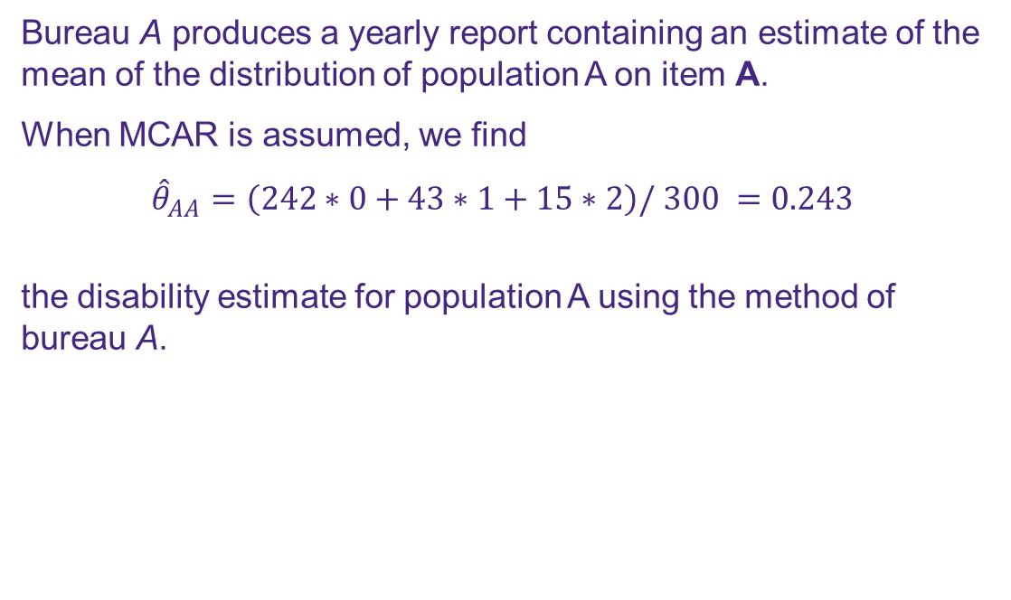
Creating Comparable Variables // Multiple Imputation
Bureau A produces a yearly report containing an estimate of the mean of the distribution of population A on item A.
When MCAR is assumed, we find
$${\hat{θ}}_{AA}=\left(242∗0+43∗1+15∗2\right)/ 300 =0.243$$
the disability estimate for population A using the method of bureau A.
Are you able to walk outdoors on flat ground?
0: Without any difficulty 242 1: With some difficulty 43 2: With much difficulty 15 3: Unable to do 0

Slide 58
Creating Comparable Variables // Multiple Imputation
The survey of bureau B contains item B:
Can you, fully independent, walk outdoors (if necessary with cane)? Obs. frequency
0: Yes, no difficulty 145 1: Yes, with some difficulty 110 2: Yes, with much difficulty 29 3: No, only with help from others 8
And there are no missing values.

Slide 59
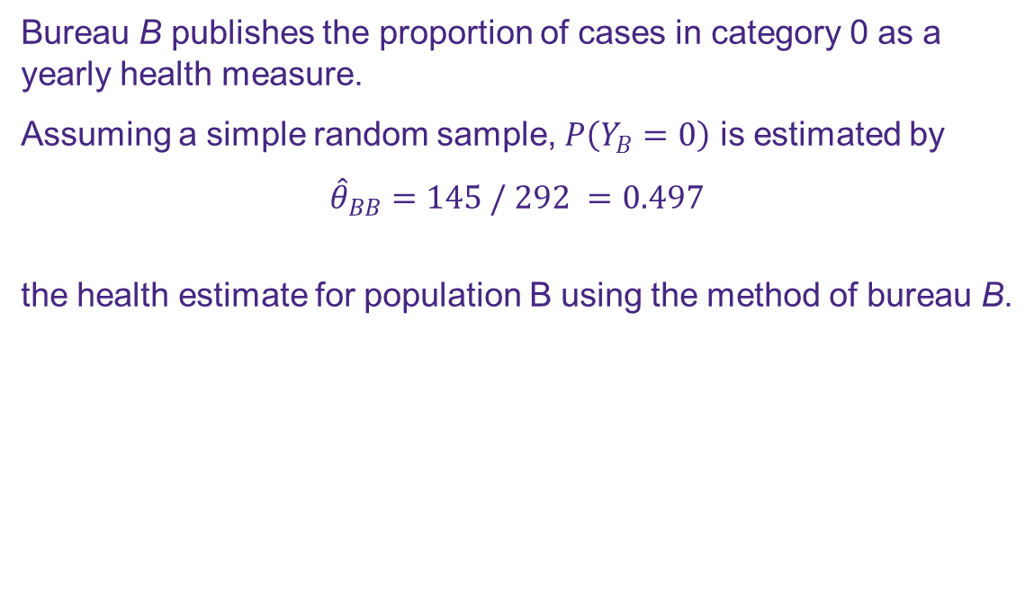
Creating Comparable Variables // Multiple Imputation
Bureau B publishes the proportion of cases in category 0 as a yearly health measure.
Assuming a simple random sample, $P\left(Y_{B}=0\right)$ is estimated by
$${\hat{θ}}_{BB}=145 / 292 =0.497$$
the health estimate for population B using the method of bureau B.
Can you, fully independent, walk outdoors (if necessary with cane)? 0: Yes, no difficulty 145 1: Yes, with some difficulty 110 2: Yes, with much difficulty 29 3: No, only with help from others 8

Slide 60
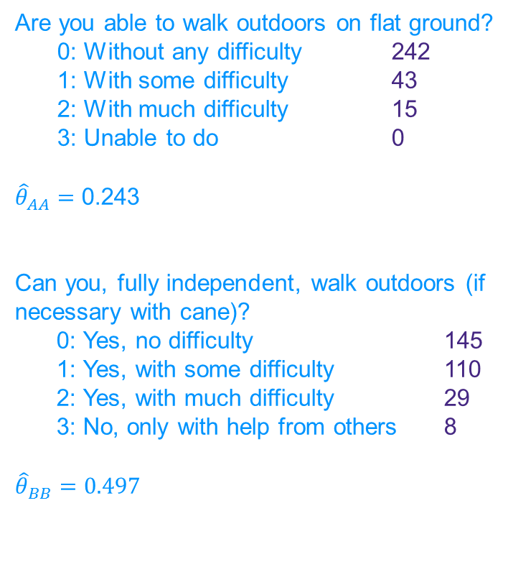
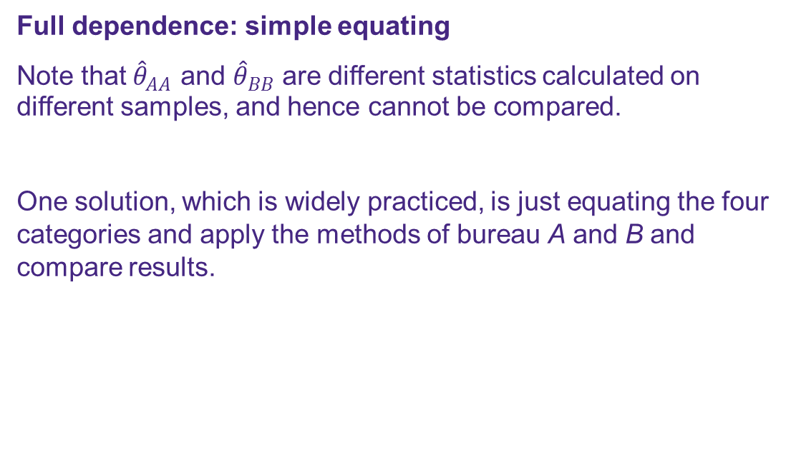
Creating Comparable Variables // Multiple Imputation
Full dependence: simple equating
Note that ${\hat{θ}}_{AA}$ and ${\hat{θ}}_{BB}$ are different statistics calculated on different samples, and hence cannot be compared.
One solution, which is widely practiced, is just equating the four categories and apply the methods of bureau A and B and compare results.
Are you able to walk outdoors on flat ground?
0: Without any difficulty 242 1: With some difficulty 43 2: With much difficulty 15 3: Unable to do 0
${\hat{θ}}_{AA}=$ 0.243
Can you, fully independent, walk outdoors (if necessary with cane)? 0: Yes, no difficulty 145 1: Yes, with some difficulty 110 2: Yes, with much difficulty 29 3: No, only with help from others 8
$${\hat{θ}}_{BB}=0.497$$

Slide 61
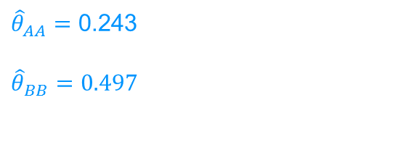
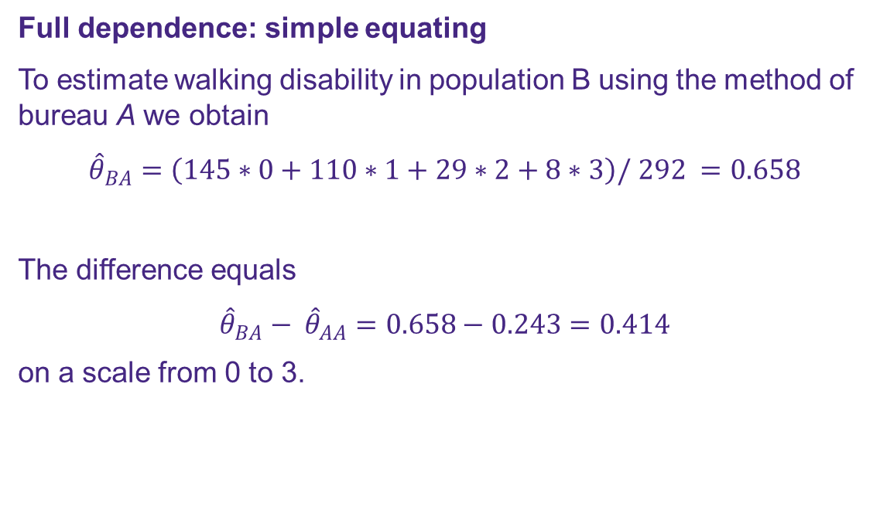
Creating Comparable Variables // Multiple Imputation
Full dependence: simple equating
To estimate walking disability in population B using the method of bureau A we obtain
$${\hat{θ}}_{BA}=\left(145∗0+110∗1+29∗2+8∗3\right)/ 292 =0.658$$
The difference equals
$${\hat{θ}}_{BA}− {\hat{θ}}_{AA}=0.658−0.243=0.414$$
on a scale from 0 to 3.
${\hat{θ}}_{AA}=$ 0.243
$${\hat{θ}}_{BB}=0.497$$

Slide 62
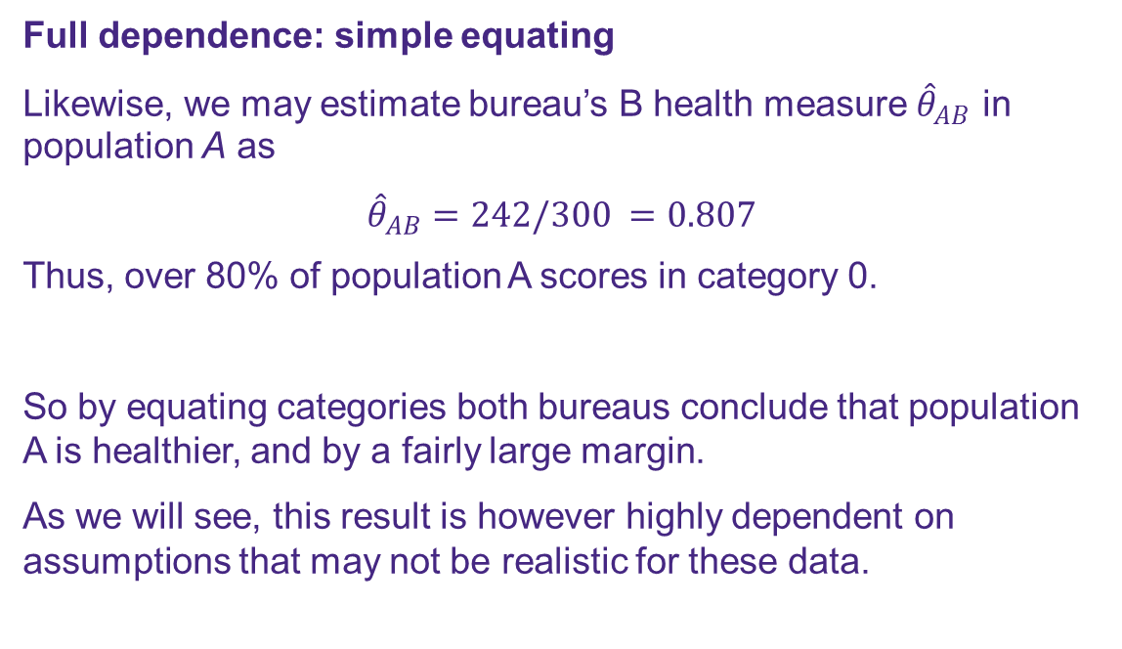
Creating Comparable Variables // Multiple Imputation
Full dependence: simple equating
Likewise, we may estimate bureau’s B health measure ${\hat{θ}}_{AB}$ in population A as
$${\hat{θ}}_{AB}=242/300 =0.807$$
Thus, over 80% of population A scores in category 0.
So by equating categories both bureaus conclude that population A is healthier, and by a fairly large margin.
As we will see, this result is however highly dependent on assumptions that may not be realistic for these data.
${\hat{θ}}_{AA}=$ 0.243
$${\hat{θ}}_{BB}=0.497$$

Slide 63
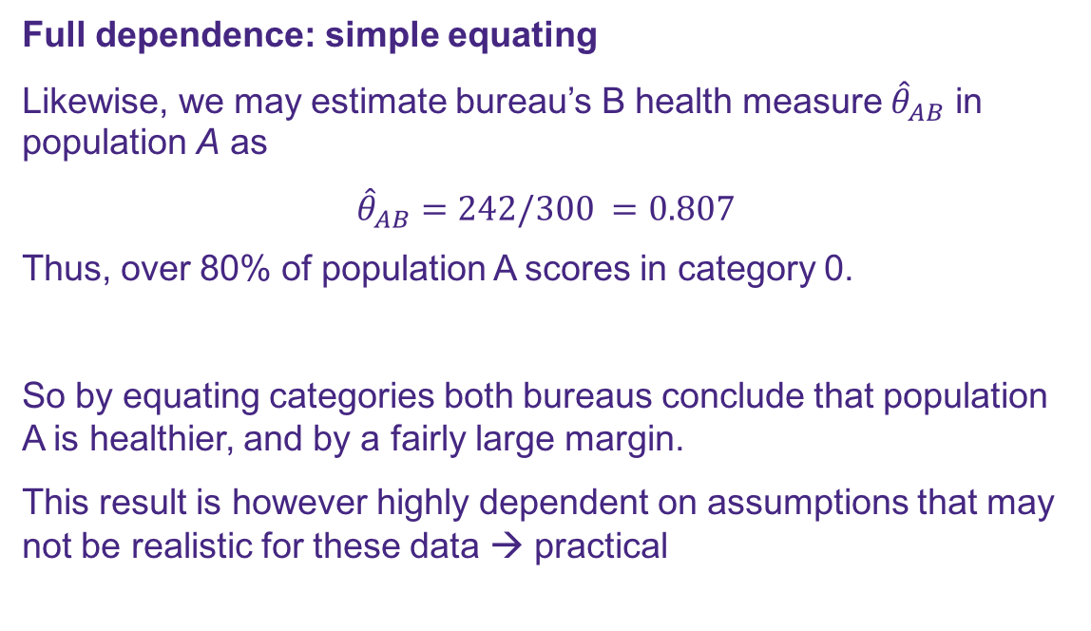
Creating Comparable Variables // Multiple Imputation
Full dependence: simple equating
Likewise, we may estimate bureau’s B health measure ${\hat{θ}}_{AB}$ in population A as
$${\hat{θ}}_{AB}=242/300 =0.807$$
Thus, over 80% of population A scores in category 0.
So by equating categories both bureaus conclude that population A is healthier, and by a fairly large margin.
This result is however highly dependent on assumptions that may not be realistic for these data → practical
${\hat{θ}}_{AA}=$ 0.243
$${\hat{θ}}_{BB}=0.497$$

Slide 64
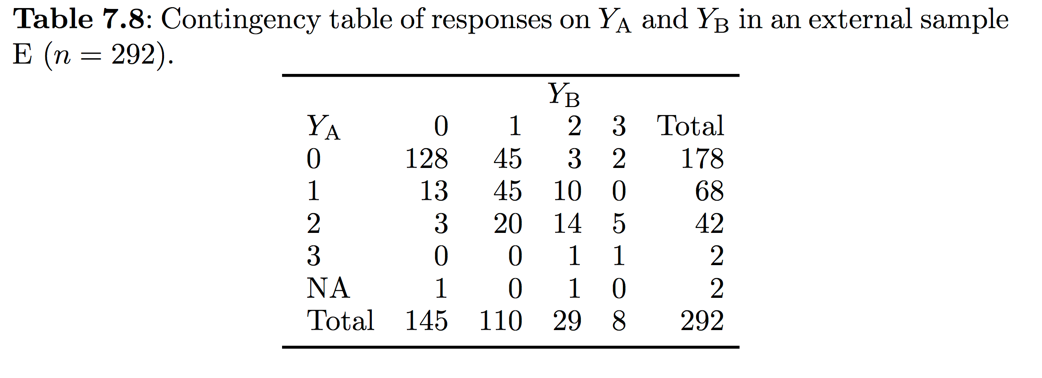
Creating Comparable Variables // Multiple Imputation
Multiple imputation will fill-in the missing parts, using the relation observed study E

Slide 65
Developmental Milestones

Slide 66
Developmental Milestones

Slide 67
Example items
Visit | Item
4 weeks | Fixates eyes
 | Reacts to speech
 | Moves both arms as much
 | Moves both legs as much
 | Lifts chin
8 weeks | Smiles in response
 | Follows with eyes and head

Slide 68
The ideal situation
One unit for development: D-score
Three desirable properties:
Difference between two D-scores measured on the same child at different ages quantifies the amount of development during the interval
Difference between the D-score measured on two different children of the same age quantifies the difference in development between them
Comparing the D-score to an age-dependent reference identifies abnormal development
We need an interval scale
We need growth references

Slide 69
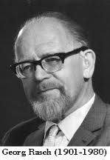
Rasch model
The probability of a “+” depends on
The ability θ_{i} of person i
The difficulty τ_{j} of item j
The difference θ_{ι} - τ_{j} drives the probability of passing

Slide 70
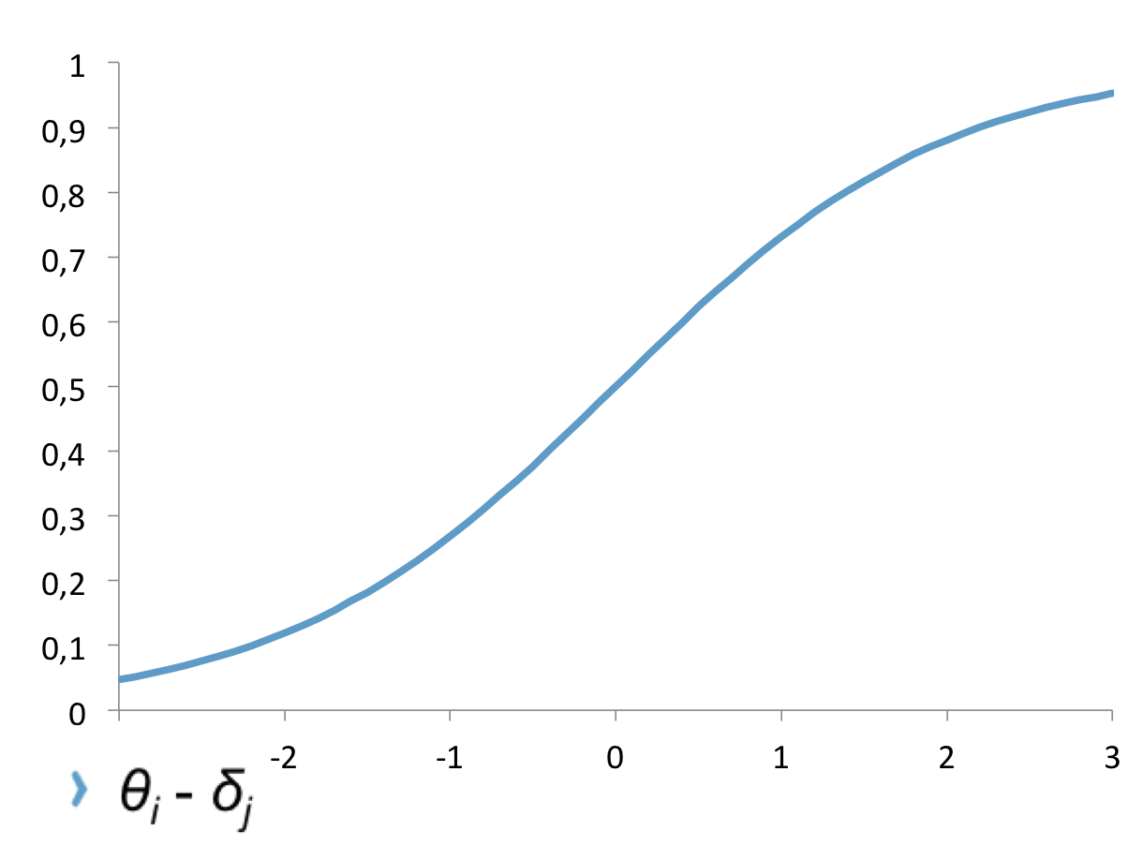

Slide 71


Slide 73
Key assumptions of the Rasch model
Unidimensionality
One-dimensional latent scale θ that expresses differences in maturation
Parallel curves
Probability of passing follows parallel logistic curves. Tests vary only in location (difficulty) on the θ axis
Local independence
At a given θ the probabilities of passing two tests are independent

Slide 74
When do we have an interval scale?
“The Rasch model, when it holds, yields measures of person abilities and item facilities on an interval scale with a common unit”
Perline R, Wright BD and Wainer H. The Rasch model as Additive Conjoint Measurement. www.rasch.org/memo24.htm

Slide 75
Follows object
Picks up a block
Can walk

Slide 78
P90
P10

Slide 80
Special properties of the D-score
Measurement scale is independent of population
Common metric, difference scores are meaningful
Common scale, the same concept across age

Slide 81
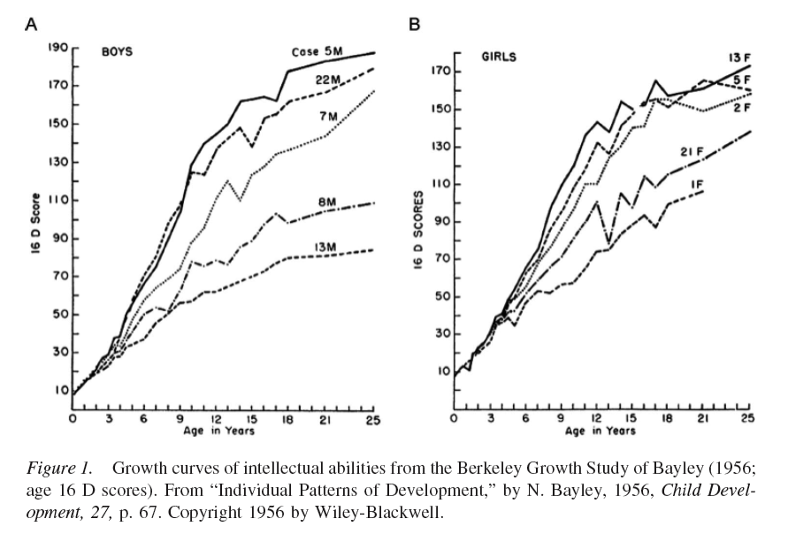

Slide 82
Relation with later IQ
Design: A selection of 619 children from SMOCC were measured again at 5 years
Measures
Background characteristics at birth (gender, SES, age mother)
0-2 years: Dutch developmental data
5-6 years: UKKI, Dutch intelligence test
Hafkamp-de Groen E, Dusseldorp E, Boere-Boonekamp MM, Jacobusse GW, Oudesluijs-Murphy AM, Verkerk PH (2009). Relatie tussen het Van Wiechenonderzoek (D-score) op 2 jaar en het intelligentieniveau op 5 jaar. Tijdschr Jeugdgezondheidsz, 1, 10-4.

Slide 83
Relation with later IQ
Pearson correlation D-score (2 yrs) with IQ (5 yrs): 0.34
Pearson correlation with background variables (0 yrs) with IQ (5 yrs)
R(SES) = 0.17; R(age mother) = 0.12
Prediction of IQ:
D-score alone predicts 11% of variance
D-score + background 16% of variance

Slide 84
D-score screening?
Can we use the D-score as a screening instrument to identify children with delayed cognitive development (50 < IQ ≤ 85)?
And if so, from what age?

Slide 85
D-score screening?
Case-control study
300 cases attending special education, 50 < IQ ≤ 85
300 controls: regular education; no developmental delay, did not repeat a class

Slide 86
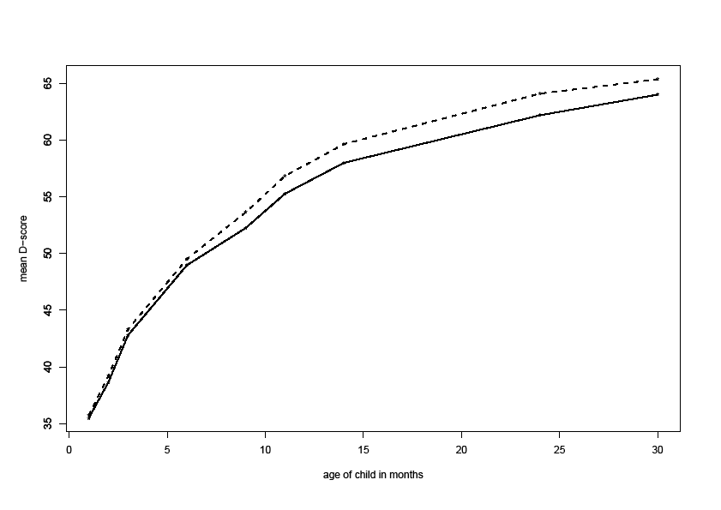
= cases
= controls
9 mth
0.001
0.61
0.59
14 mth
0.001
0.65
0.64
24 mth
0.001
0.96
0.70
P-value:
Cohen’s d:
AUC:

Slide 87
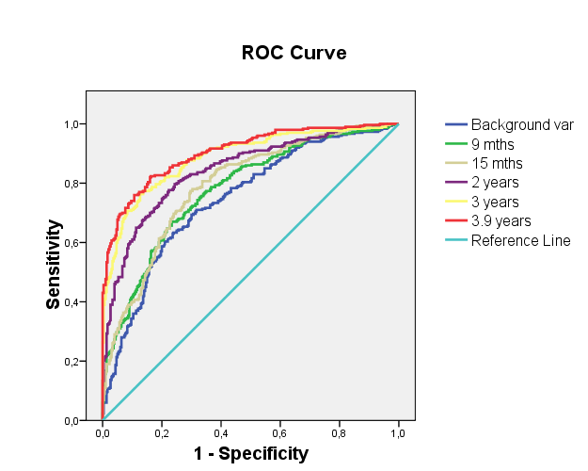
14

Slide 88
Does it work for other countries?
Country | Investigators | Bayley | Denver | Griffiths | Battelle | Other
Bangladesh | Hamadani*, Tofail | X |  |  |  | X
Brazil (1993) | Menezes, Victora, Karam* |  | X
Brazil (2004) | Barros, Victora, Karam* |  |  |  | X
Chile | Lozoff* | X |  |  |  | X
Chile | Behrman, Bravo, Fernald*, Reynolds |  |  |  |  | X
China | Lozoff* | X
Colombia (Bogota) | Attanasio*, McGregor*, Rubio-Codina* | X | X |  | X | X
Colombia | Attanasio*, McGregor*, Rubio-Codina* | X |  |  |  | X
Ecuador | Araujo*, Schady |  |  |  |  | X
Ethiopia | Hanlon*, Medhin | X
Jamaica | Walker*, Chang* |  |  | X
Jamaica | McGregor*, Powell |  |  | X
Madagascar | Galasso, Fernald*, Ratsifandrihamanana*, Weber* |  |  |  |  | X
Netherlands | Verkerk, Schönbeck, Van Buuren* |  |  |  |  | X
South Africa | Richter*, Cameron | X |  | X
Database
16 cohorts
> 75000 records
> 1300 items
Expert equality mapping at item level
Which items form a scale?

Slide 89
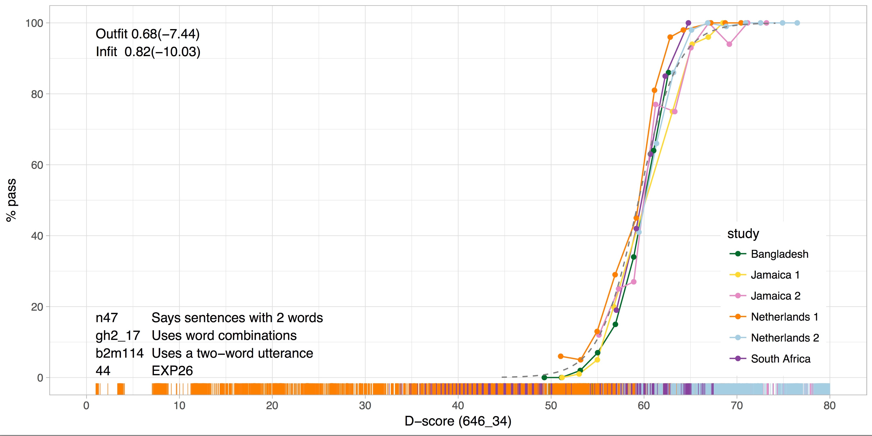
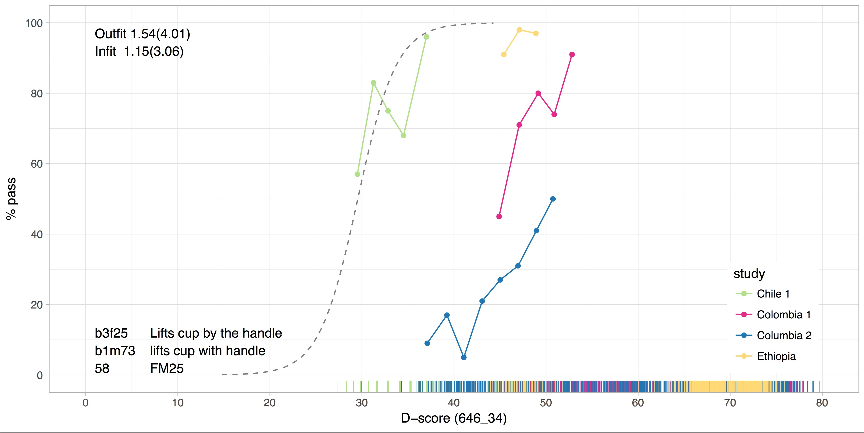
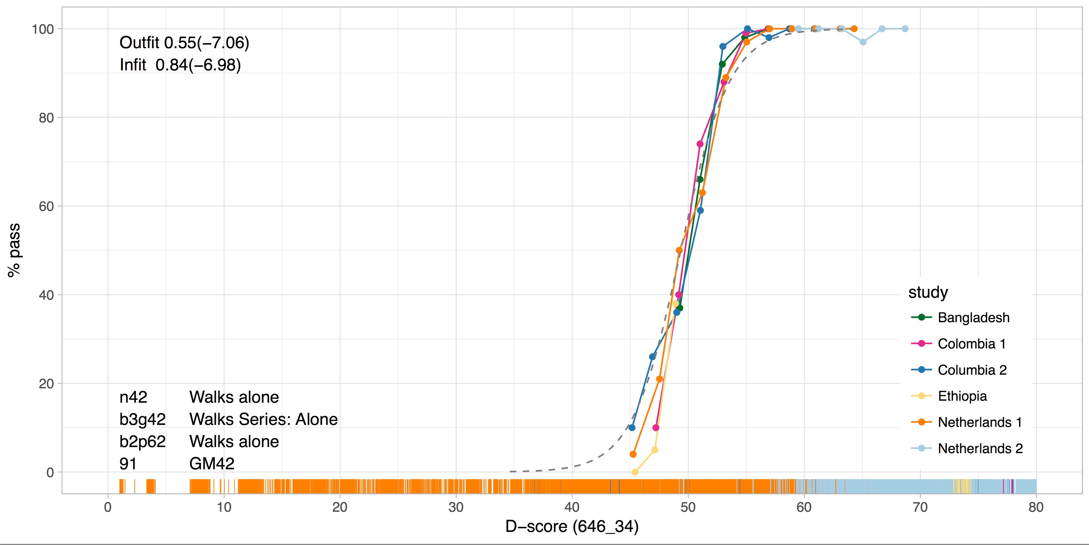
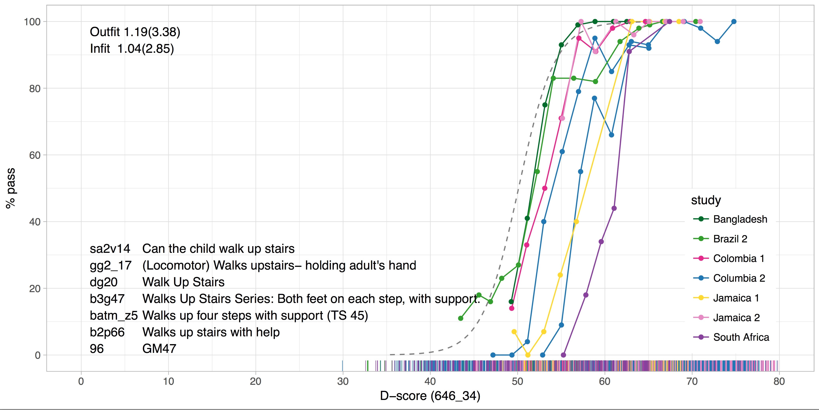

Slide 90
Preliminary result
© Bill & Melinda Gates Foundation

Slide 91
Relevance D-score for RECAP
Way to harmonize different scales of child development in existing data
Way to compare child development to a norm
Some scientific questions of interest:
Is gestational age inversely related to the risk of developmental delay?
Should we correct the D-score and DAZ for differences in gestational age, and if so, how?
Does the D-score predict later health, school succes, quality of life, and so on?
Can the D-score be used to identify (and treat) children before delay sets in?

Slide 92
Loss to Follow Up

Slide 93
Loss to Follow Up
Inclusion
Follow-up
Problem: Loss to follow-up can undermine the representativeness of estimates and introduce non-differential biases.
Usual approach: to ignore them
But, other approachs are possibles:
- Multiple imputation
- Inverse probability weighting (IPW)
Assumption with these approaches:
- For imputation: loss to follow up have to be MAR or MCAR
ID X1 X2
1
2
3
4
5
6
ID Y1
1
4
3
2
5
6
Responders
Non-responders

Slide 94
Loss to Follow Up // Imputation
Recall: missing values are replaced by plausible values using chained equations method.
Step 1: To impute data
What variables should be in the imputation model?
Factors associated with the probability of follow-up and outcome
Outcome
Follow-up
Step 2: Estimate outcome from imputed datasets

Slide 95
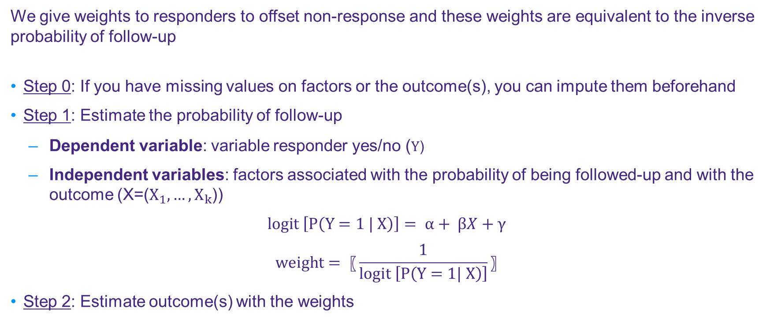
Loss to Follow Up // Inverse Probability Weighting
We give weights to responders to offset non-response and these weights are equivalent to the inverse probability of follow-up
Step 0: If you have missing values on factors or the outcome(s), you can impute them beforehand
Step 1: Estimate the probability of follow-up
Dependent variable: variable responder yes/no ($Y$)
Independent variables: factors associated with the probability of being followed-up and with the outcome (X=($X_{1},…,X_{k}$))
$$logit \left[P\left(Y=1 | X\right)\right]= α+ βX+γ$$
$$weight= 〖\frac{1}{logit \left[P\left(Y=1| X\right)\right]}〗$$
Step 2: Estimate outcome(s) with the weights

Slide 96
Loss to Follow Up // Exercise
Objective: Assess the potential impact of perinatal factors on the estimated prevalence of neurodevelopmental delay with respect to non response.
Data: Perinatal data were collected from medical records during the neonatal hospitalization and a parental questionnaire at 2 years of corrected age was sent to assess neurodevelopmental delay using a standardized parental report instrument.
Variables:
follow: the child is followed up at 2 years – Yes/No
Outcome
gmi_vi_hi_parca_asq_ten2: the child has a neurodevelopmental delay – Yes/No/Missing values
Perinatal factors :
a4_weeks: gestational age of the child – (range: 23-31)
motherage: mother’s age (range:14-53) / Missing values
native2: the mother is inborn in country – Yes/No/Missing values
f10: Was infant receiving human milk at discharge? - Yes/No/Missing values

Slide 97
Multilevel Analysis
Notes:
Multilevel model assumes no longer independence between all subjects.

Slide 98
Multilevel Analysis
Three types of analysis when combining data from different cohorts:
Separate model for each cohort
Dummy variable for each cohort
One general model by means of a multilevel model
Multilevel model (mixed effects model) consists of two parts:
Fixed effects
Random effects (allows for different effects per country/cohort)
Notes:
Multilevel model assumes no longer independence between all subjects.

Slide 99
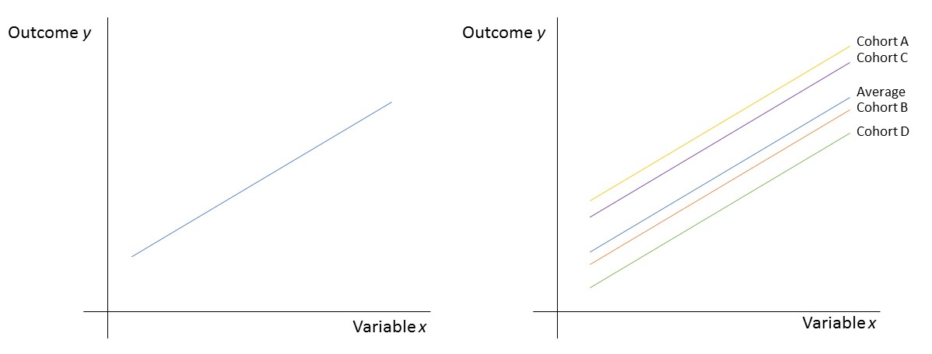
Multilevel Analysis // Mixed effects model
Random intercept

Slide 100
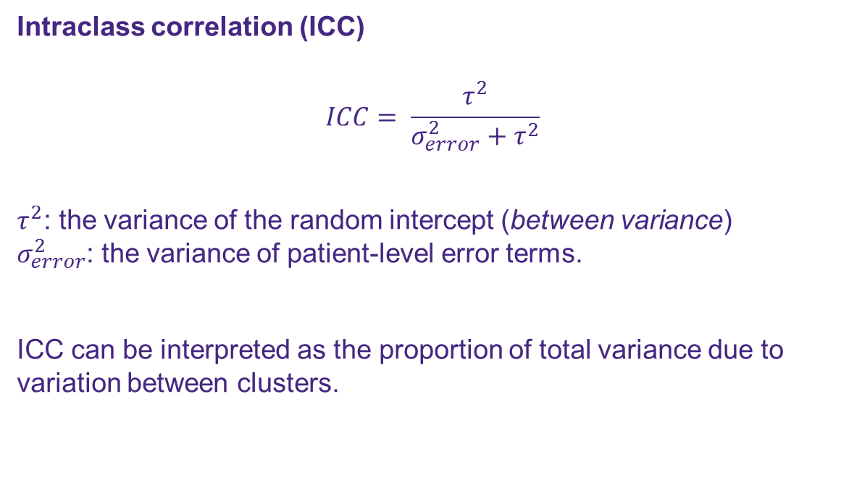
Multilevel Analysis // Mixed effects model
Intraclass correlation (ICC)
$$ICC= \frac{τ^{2}}{σ_{error}^{2}+τ^{2}}$$
$τ^{2}$: the variance of the random intercept (between variance) $σ_{error}^{2}$: the variance of patient-level error terms.
ICC can be interpreted as the proportion of total variance due to variation between clusters.
Rule of thumb:
ICC > 5%
→ Model the correlation structure, e.g. by using a mixed effects model.
ICC < 5%
Add country as a categorical variable

Slide 101
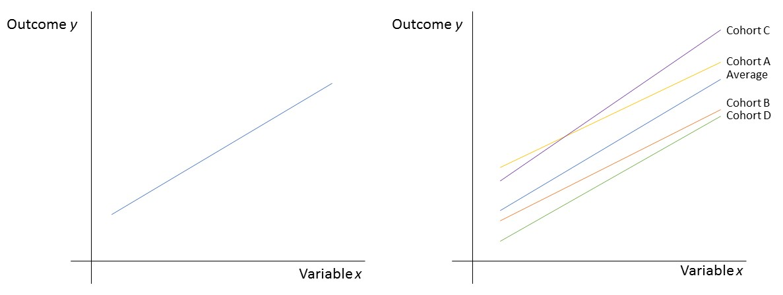
Multilevel Analysis // Mixed effects model
Random intercept and random slope

Slide 102
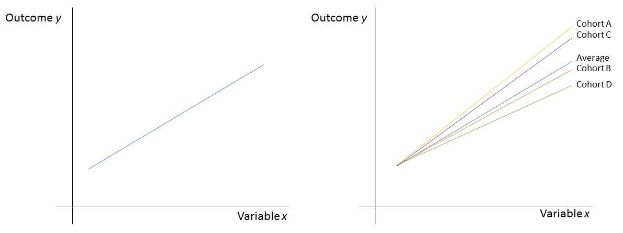
Multilevel Analysis // Mixed effects model
Random slope (no random intercept)

Slide 103
Multilevel Analysis
Variables can be added to a model on multiple levels:
Country A
Child
A1
A2
Country
A3
World
World
Country C
Country B
B1
B2
C1
C2

Slide 104
Multilevel Analysis
An higher level variable is always also allocated to the lower levels.
A variable explaining variation within the country (a country-level variable) will also be allocated to the child
Example:
Relation between gestational age and birthweight.
Country A
Child
A1
A2
Country
A3
World
World
Country C
Country B
B1
B2
C1
C2

Slide 105
Multilevel Analysis
Each country might have different relation(s) between the predictor(s) and the outcome
Hence, have its own model to explain the outcome.
Using mixed effects model we can combine the models of the countries to one general model.
Country A
Child
A1
A2
Country
A3
World
World
Country C
Country B
B1
B2
C1
C2

Slide 106
Multilevel Analysis
For each level the total variability can be explained by two sources:
Within cluster variability
Between cluster variability
Country A
Child
A1
A2
Country
A3
World
World
Country C
Country B
B1
B2
C1
C2

Slide 107
Multilevel Analysis // Conclusion
Problem: combining data of cohort studies
Usual approach: dummy variable for each cohort study
Assumption with this approach: it is assumed that the cohorts are independent of each other.
Solutions available: mixed effects model
How does it work?: allows for fixed and random effects. The random effects can capture the dependence of observations.

